Slide 1
Simple Models
Statistical Literacy, cont.
Data Science, Week 3

Slide 2
Topics
Stdev and Quantiles as Quantification of Uncertainty
  Sample versions
  „Tails“, p-values, „unlikely events“
Bias-Variance Tradeoff and Sample Sizes
  Temperature Predictions as KNN
  Histograms
  The Magic of Simulations
Binary Outcomes
  Titanic
Loss Functions, cont.
Correlations
  Penguins
…

Slide 3
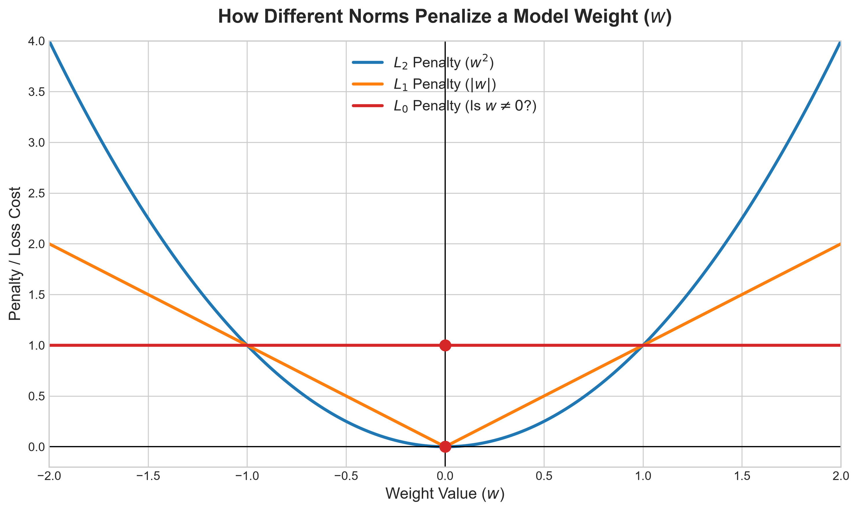
Loss Functions
Open Questions:
Quality Metric
Symmetry
Categorical/Binary Outcome

Slide 4
When is one prediction error worse than the other?
Asymmetric loss: the direction of the error matters.
ELECTRICITY DEMAND
Underpredict → demand may exceed supply, risking outages.
Overpredict → spare capacity costs money.
INVENTORY
Underpredict → stockouts and lost sales.
Overpredict → leftover stock and storage costs.
HOSPITAL CAPACITY
Underpredict → too few beds or staff.
Overpredict → unused capacity and extra cost.
TRAVEL TIME
Underpredict → missed flights or appointments.
Overpredict → arriving early and waiting.
Example: a shortage may be much more costly than having a small surplus.

Slide 5
Asymmetric absolute loss
Underprediction and overprediction can have different costs.
DEFINE THE ERROR
e = actual − prediction
Underpredict (e > 0): loss = 5e
Overpredict (e < 0): loss = −e
INTERPRETATION
Missing one unit costs €5; having one extra unit costs €1. The loss rises five times faster for underprediction.
The optimal prediction depends on the relative costs of the two kinds of error.

Slide 6
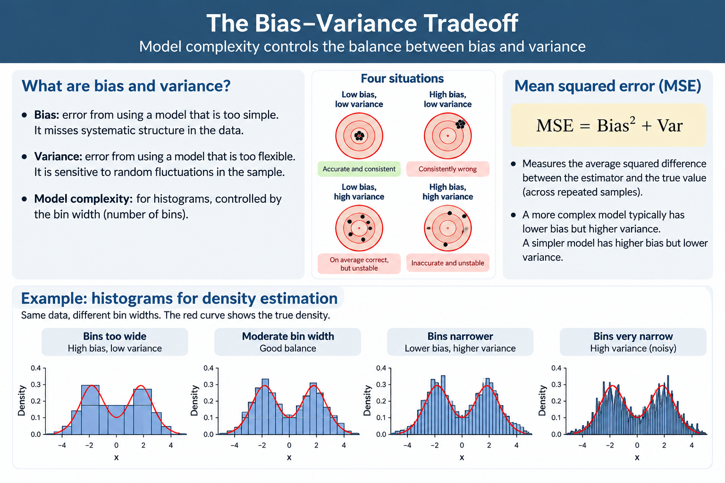

Slide 7



A. Sturges' rule
  Often too conservative for large datasets or distributions with complex structure.
B. Scott's rule
A useful theoretical starting point under approximately normal-density assumptions.
C. Freedman–Diaconis rule
Notes:
Freedman: Often my preferred rule to teach first because students can connect it to the robust statistics they learn elsewhere. It is less sensitive to extreme observations than Scott's rule.

